Slide 1


Physics labs that resonate with pre-medicine students
Alexandra M. Hopps, Madeline Harmer, Nathan D. Powers, Adam Bennion, M. Jeannette Lawler
AAPT Summer 2022 | Brigham Young University
Notes:
Put pictures with names final slide and thank the team that worked on this project

Slide 2
Demographics
Physics 108 is the lab class that covers electricity, magnetism, optics, and modern physics
About 300 students enrolled each semester
1-2 Teaching Assistants for each section (~20 students)
Students work in groups of 3-4
Students meet once a week for a two-hour block
80% planning to enter the health professions
1
Notes:
Make the 80 and the first bullet combine to one- don’t need to specify biology and pre-medicine , say about 300 students, divided into sections with 7 groups with 1 or 2 TAs – can talk about how they meet for a two-hour block once a week, give more context to the class. Playdoh (movement of ions) - electrophoresis, relates to how to brain functions – say that previous medical related labs inspired our decision to create an MRI lab. It is important to note that we have been working to help students model things that are relevant to the medical field, for instance labs on the otics of the eye and perception of color and labs that approach circuits similar to how the brain works. Do this vs this (optics of the eye vs general optics) I want to talk about a lab where we take magnetic resonance and we make it relevant to the medical field

Slide 3
Lab Class Goals
Construction of knowledge, not verification of physics principles
Project-based labs with emphasis in scientific modeling
Student designed experiments
Physics labs that are relevant to biomedicine
Ex: Optics of the eye vs. general optics
Ex: Labs that explore circuits similar to the brain vs general circuitry
Communicate their scientific findings
2
Notes:
Other people have done this in the past

Slide 4
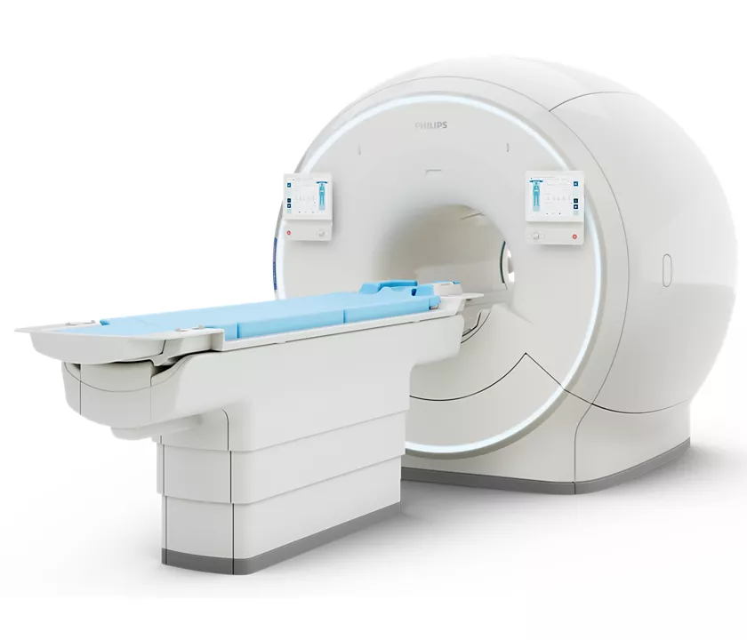
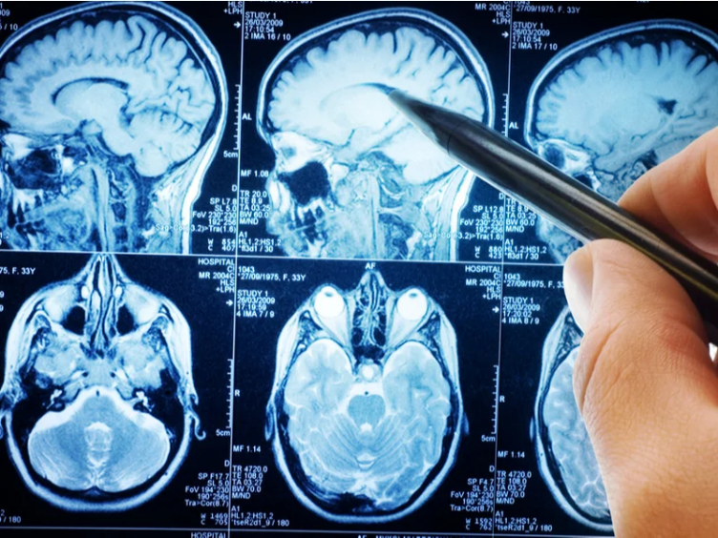
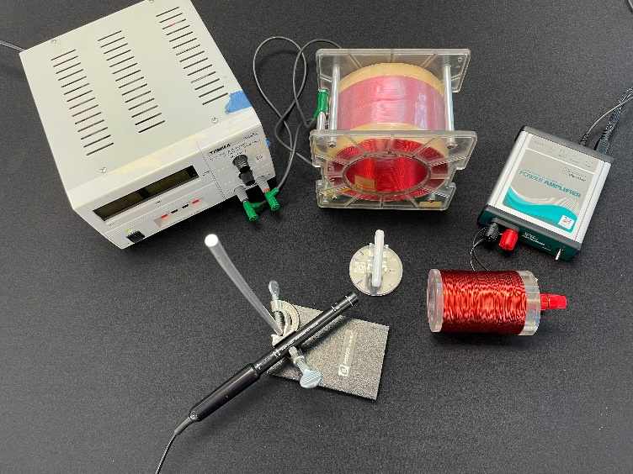
Outline of MRI Lab
Introduction to equipment
Research MRI machines
Student designed experiments
Data analysis
Presentation of Results
https://www.usa.philips.com/healthcare/product/HC781358/ingenia-elition-30t-x
https://www.medicaldevice-network.com/news/mri-for-depression/
3
Notes:
Other people have done this in the past

Slide 5
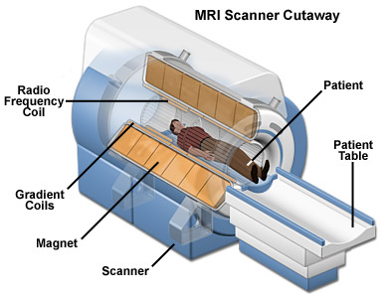
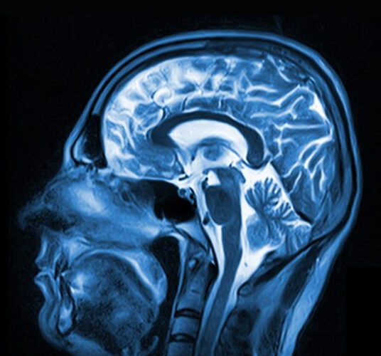
Magnetic Resonance Imaging
https://nationalmaglab.org/education/magnet-academy/learn-the-basics/stories/mri-a-guided-tour
https://swdic.com/services/magnetic-resonance-imaging/mri-brain/
4
Notes:
Madi said that because my audience is physics teachers that I can make the background info very brief. Mri machine: https://nationalmaglab.org/education/magnet-academy/learn-the-basics/stories/mri-a-guided-tour
Scan: https://swdic.com/services/magnetic-resonance-imaging/mri-brain/

Slide 6
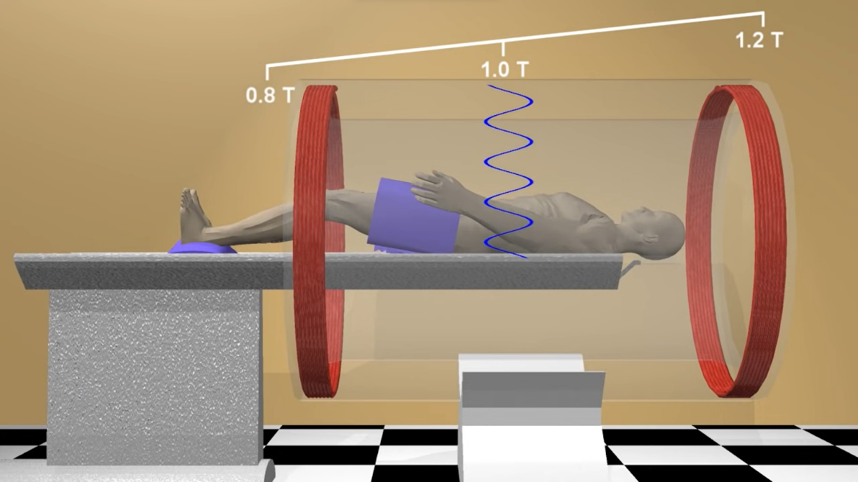
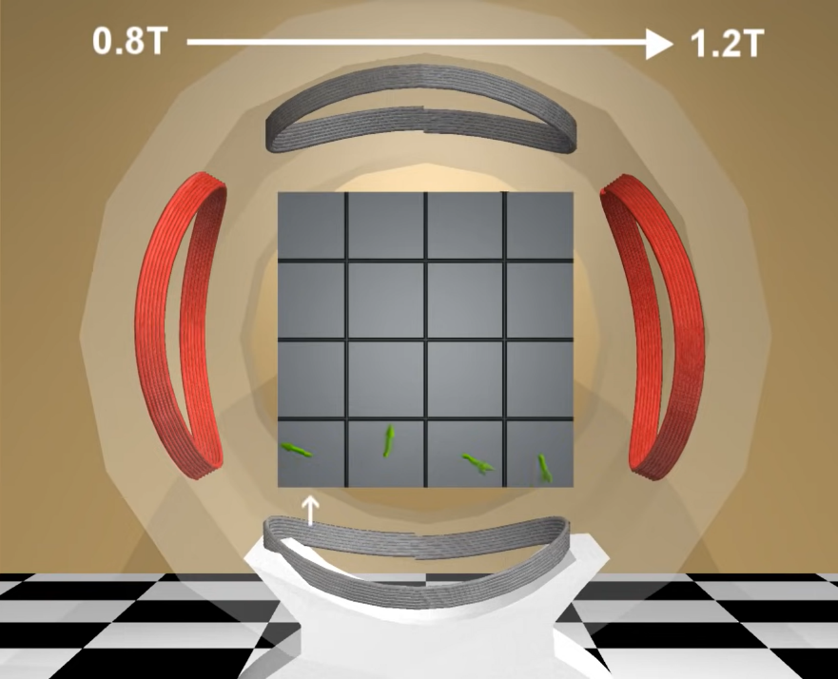
Magnetic Resonance Imaging
Key concepts for our model:
MRI machines are extremely powerful electromagnets
Gradient magnetic field causes different resonant frequencies
Radio frequency coils sweep through frequencies
Knowing the resonant frequency is important for imaging purposes
Creates a scan of up to a precision of up to 1 to 0.1 mm
https://www.youtube.com/watch?v=djAxjtN_7VE
5
Notes:
Gradient pics: MRI: Basic Physics & a Brief History – YouTube
What we want students to understand: gradient magnetic field and how the gradient magnetic field influences the frequency of the signal sent.
Simplify explanation

Slide 7
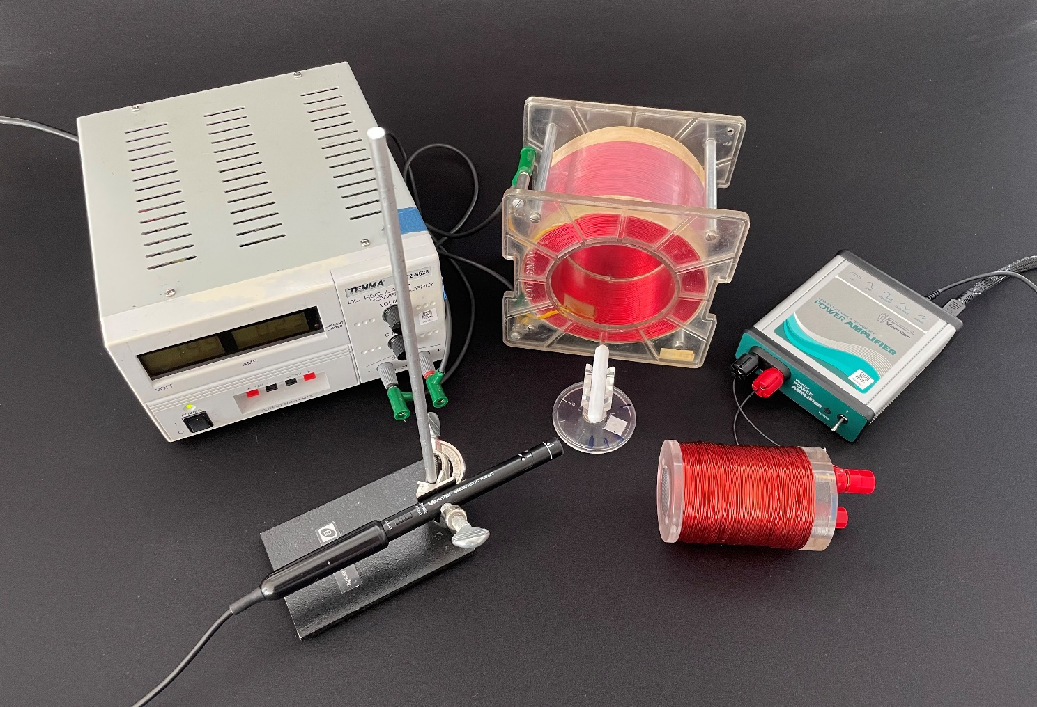
Model MRI Machine
Gradient Coil
Materials:
Large solenoid connected to DC
Small solenoid connected to AC
Vernier Magnetic Field Sensor
Bar magnet with low friction pivot table
Bar Magnet
Magnetic Field Sensor
AC Coil
6
Notes:
Connect each piece of equipment to what it would be on an actual mri machine

Slide 8
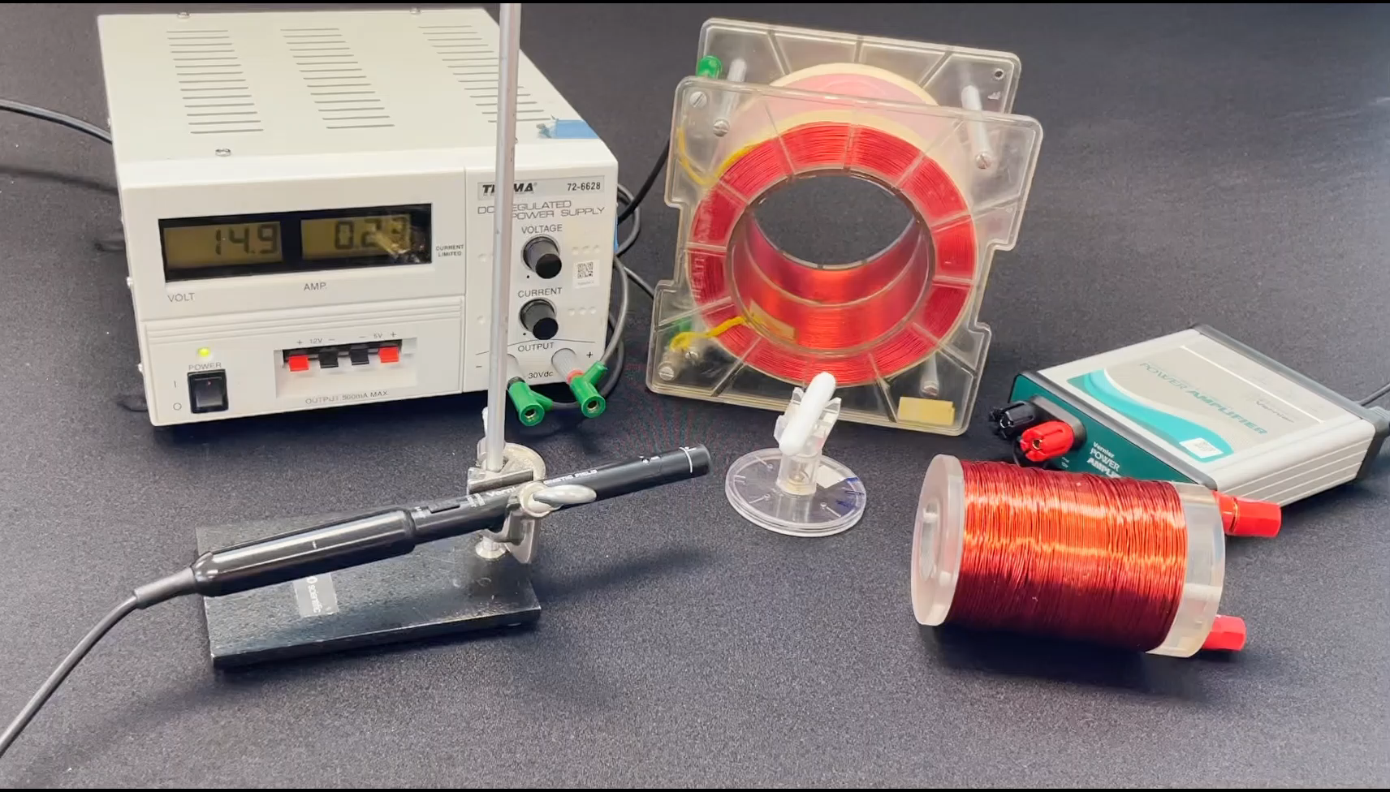
Data Collection
Observational experiment:
The amplitude of the oscillations changes depending on the frequency
7
Notes:
Mention the gradient magnetic field in the model mri

Slide 9
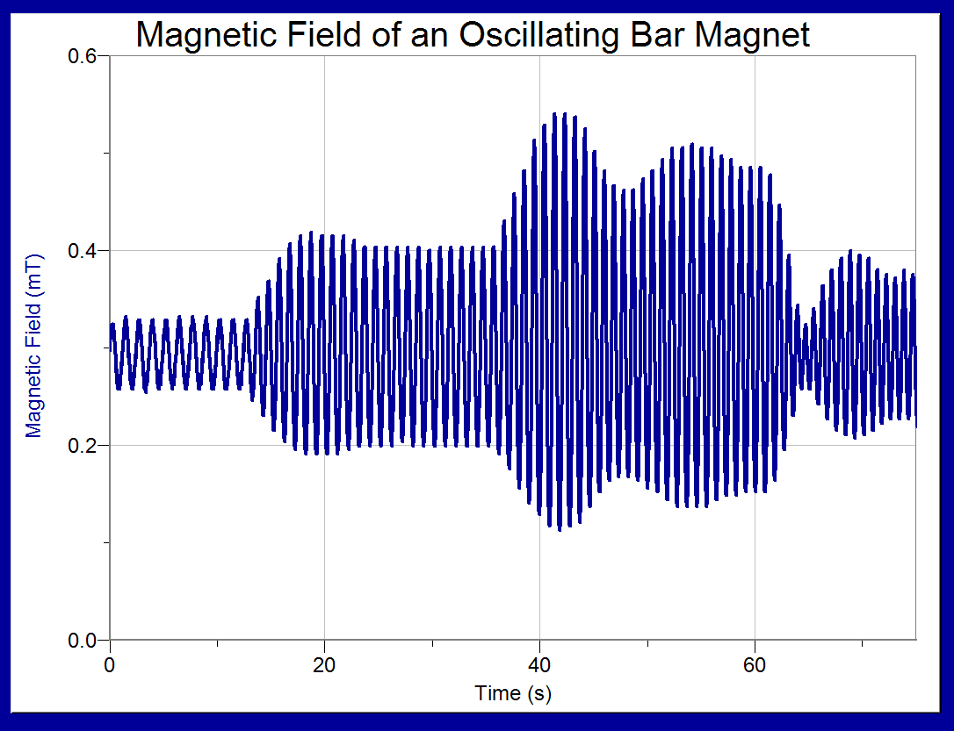
Data Collected
Measured Resonant Frequency:
Students determine the resonant frequency using a hall probe and LoggerPro Software
0.9 Hz
1.2 Hz
1.0 Hz
1.1 Hz
8
Notes:
A lot of students noticed beating when they got to the resonant frequency. Why?
Do a little video.

Slide 10
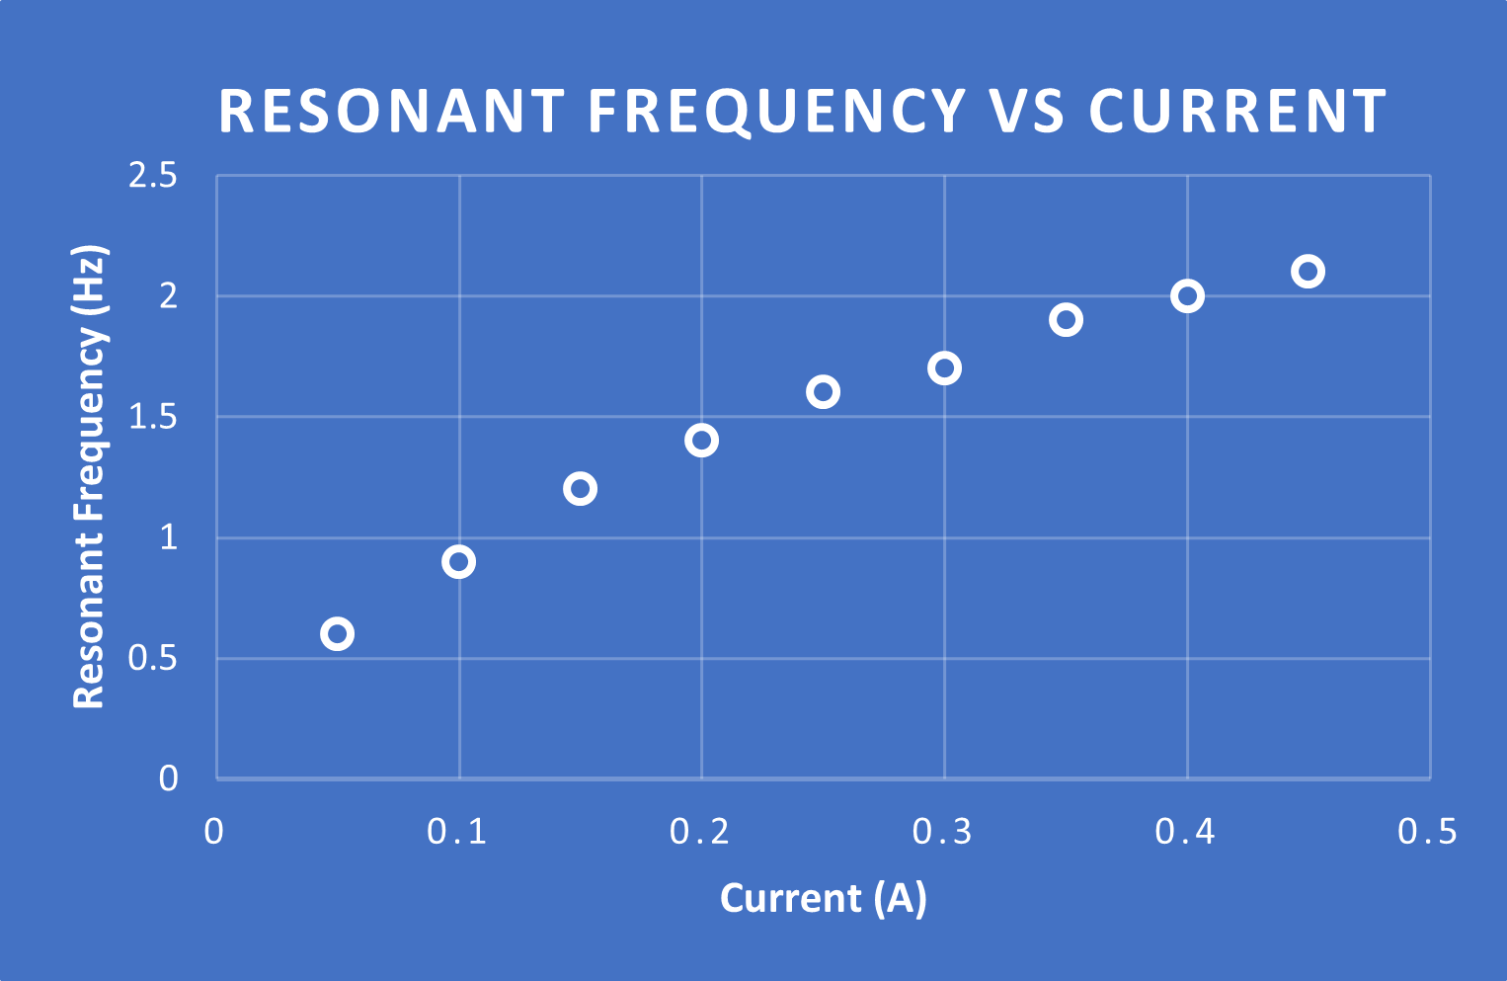
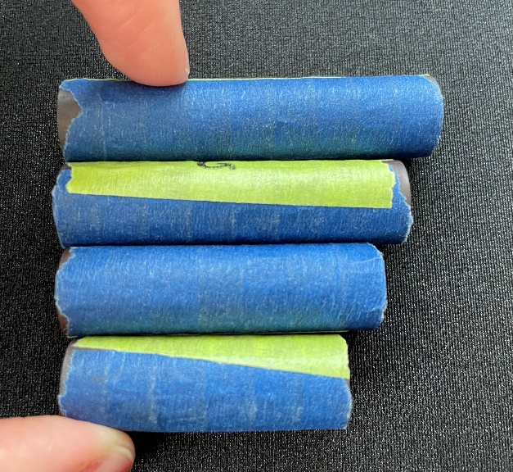
Data Collected
Student Designed Experiment
Relationship between magnetic field strength and resonant frequency
Relationship between mass and resonant frequency
9
Notes:
These were two options given, but in the future we would like to make this even more open ended (explore damping effects?)
Talk about how students chose what they Students took different approaches to each of these experiments. Some students moved the solenoid, some students moved the bar magnet, some students taped everything to the table

Slide 11
Analysis of Lab Reports
Areas of improvement
More structure
Many students did not know when the magnet was resonating
Greater focus on modeling
Many students linear fit to their data without considering how that would stand against their model
1.2 Hz
1.0 Hz
1.1 Hz
9
Notes:
These were two options given, but in the future we would like to make this even more open ended (explore damping effects?)
Talk about how students chose what they Students took different approaches to each of these experiments. Some students moved the solenoid, some students moved the bar magnet, some students taped everything to the table

Slide 12
Conclusion
Met the following goals:
Project-based lab
Student designed experiment
Connected to biomedicine
Explored a model
We surveyed students on future impact and on modeling before and after the lab.
We are still analyzing the data
10
Notes:
Have a couple of things that you can say about the data here

Slide 13
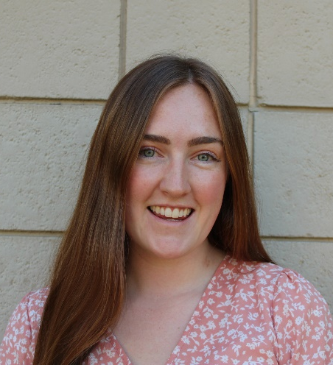


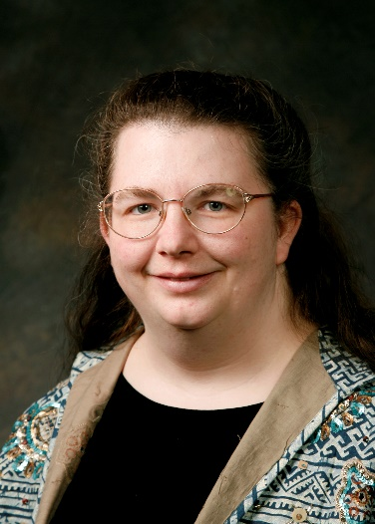

Our Team
Alexandra M Hopps
Madeline Harmer
Nathan D. Powers
M. Jeannette Lawler
Adam Bennion
11
Notes:
Have a couple of things that you can say about the data here

Slide 14
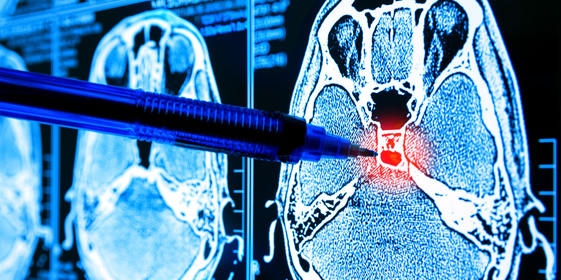
Questions?
12

Slide 15
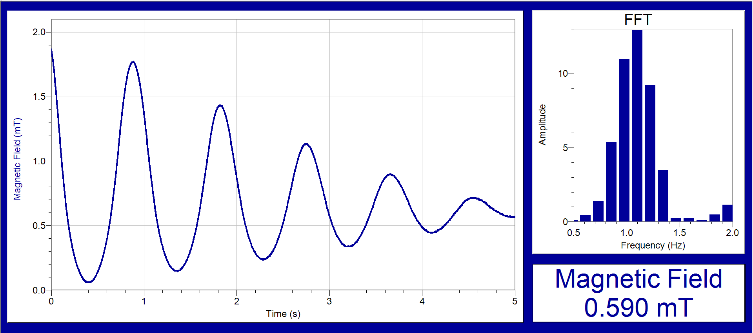
An alternative to driving the frequency is to see the natural frequency that the magnet oscillates when flicked
Notes:
Focus not just on the challenges but also how the students overcame them. More preogressive/positive. How challenges helped with understanding

